Slide 1

Real-Time AI-Powered Voice Translator
Introducing a cutting-edge real-time voice translator powered by advanced artificial intelligence technologies. This innovative system leverages Google Cloud and its powerful tools to accurately translate voice into multiple languages, revolutionizing cross-language communication.
Hackathon GENAI Supinfo

Slide 2
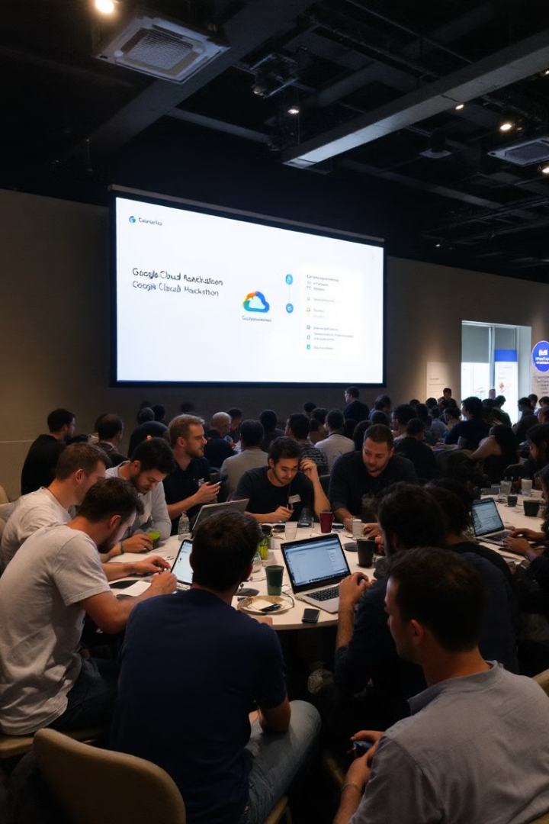
Project Context
Google Cloud Hackathon
Google Cloud Tools
This project will rely on Google Cloud and its tools (such as Vertex AI and Cloud AI APIs) to implement an innovative and functional system that accurately translates voice into multiple languages.
As part of the Google Cloud Hackathon, the objective is to design a real-time voice translator using advanced artificial intelligence technologies.

Slide 3
Project Objectives
Main Objectives
Secondary Objectives
Innovations
Develop an application capable of translating voice in real-time into multiple languages.
Integrate a communication server to transmit translations to external listening devices.
Integration with generative models like Gemini to enrich translations by adding context.
Leverage existing AI models on Vertex AI to minimize development time.
Provide educational feedback for users wishing to improve their diction or learn a new language.
Deployment of an intuitive and attractive user interface (UI).
Implement the following technologies:
Speech-to-Text (voice recognition).
Text-to-Text (text translation).
Text-to-Speech (voice synthesis).

Slide 4
Functional Requirements
1
Real-time Translation
2
Linguistic Flexibility
3
User Interface
Real-time recognition and translation with minimal latency.
Allow users to choose input and output languages.
Simple, providing real-time visual feedback of translations
4
Educational Features
5
Interoperability
Suggestions to improve diction. Grammar indications in the translated language
The system must be compatible with various listening devices.

Slide 5
Technical Requirements
Google Cloud Services
1
Speech-to-Text API. Translate API. Text-to-Speech API.
2
Languages
Python (integration with Google APIs and UI).
Libraries
3
sounddevice for audio stream management. queue for synchronizing processing steps.
4
Performance Requirements
Total processing time (voice → text → translation → voice) under 2 seconds. Stable audio stream management, even with interruptions or silences.
Architecture
5
A system based on a parallel pipeline to simultaneously manage different steps (capture → transcribe → translate → synthesize). Automatic restart capability upon detecting silence.
6
Modifiable Parameters
Input and output languages. Silence detection timeout.
Scalability
7
Optimized to work on constrained environments (standard laptops or cloud servers). Extensible features to include other languages or dialects.

Slide 6




Non-Functional Requirements
Security
Audio streams must not be recorded or shared without explicit consent. Data must be processed in a secure Google Cloud environment.
Accessibility
User interface accessible to individuals with visual or hearing impairments.
Robustness
Resistant to network errors or audio input interruptions.

